Slide 1
TUTORIAL QUESTIONS FOR ELECTRONICS II

Slide 2

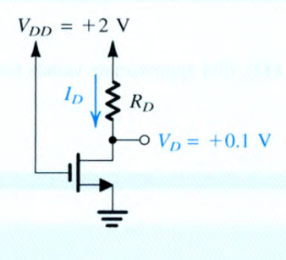

Find $I_{D} andR_{D}$

Slide 3
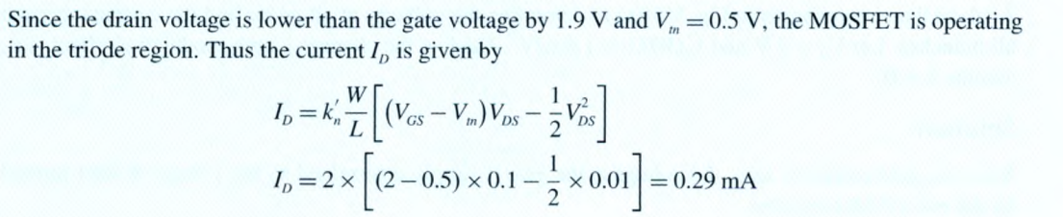
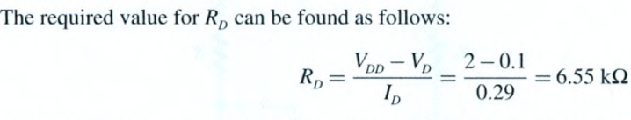

Slide 4
5–3. The output of an AND gate with one of its inputs connected to 1 will always output a level equal to the level at the other input. True or false? 5–4. The output of an OR gate with one of its inputs connected to 1 will always output a level equal to the level at the other input. True or false? 5–5. If one input to an OR gate is connected to 0, the output will always be 0 regardless of the level on the other input. True or false?

Slide 5
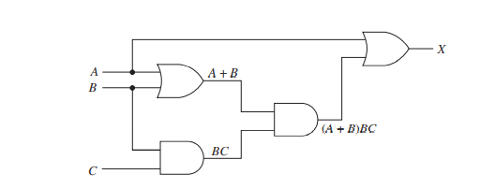
Simplify The Output X And Draw The Logic Circuit For The Simplified Boolean Expression.

Slide 6
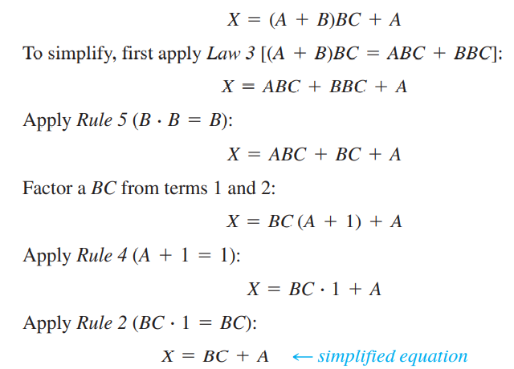
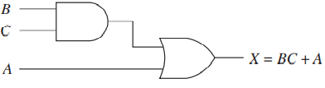

Slide 7
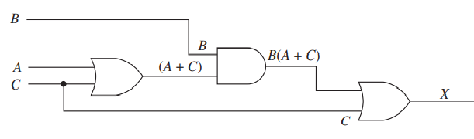
Simplify The Output X And Draw The Logic Circuit For The Simplified Boolean Expression.

Slide 8
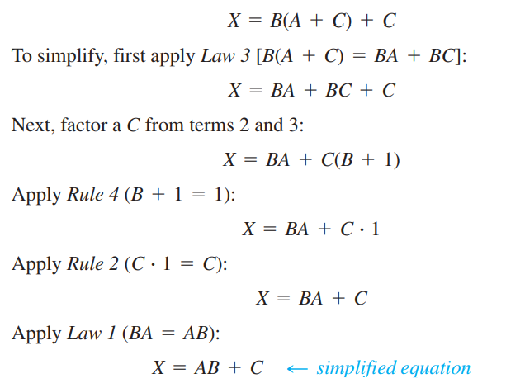
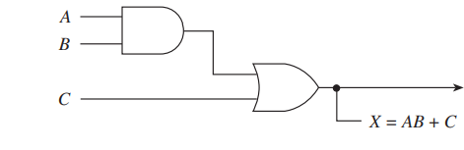

Slide 9
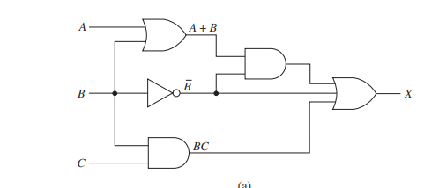
Simplify The Output X And Draw The Logic Circuit For The Simplified Boolean Expression.

Slide 10
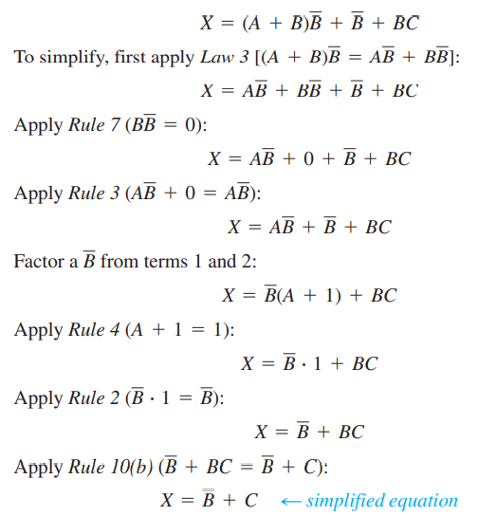


Slide 11
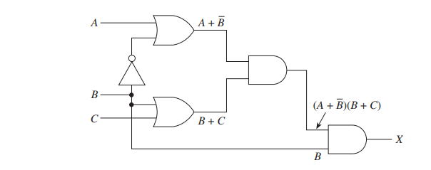
Simplify The Output X And Draw The Logic Circuit For The Simplified Boolean Expression.

Slide 12
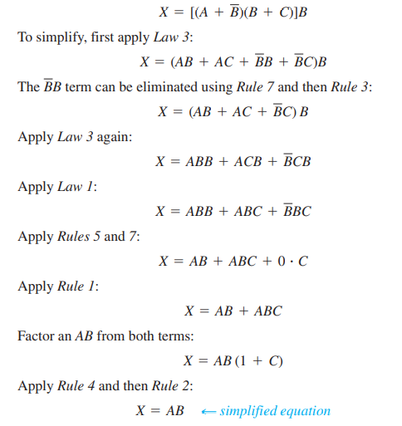


Slide 13
DEMORGANS THEORY

Slide 14
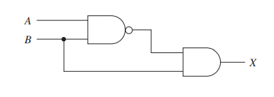
Simplify The Output X And Draw The Logic Circuit For The Simplified Boolean Expression.

Slide 15
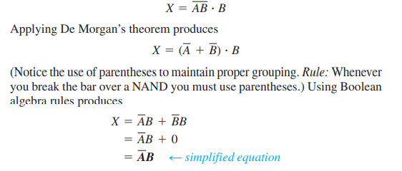
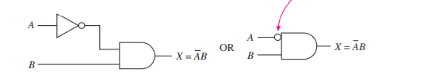

Slide 16
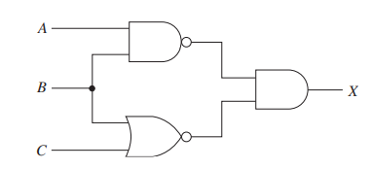
Simplify The Output X And Draw The Logic Circuit For The Simplified Boolean Expression.

Slide 17
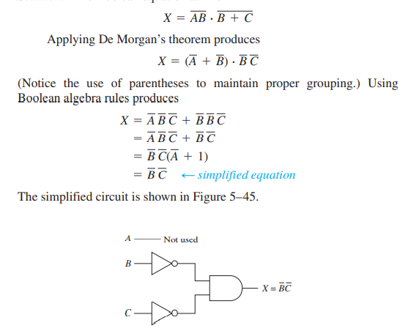

Slide 18
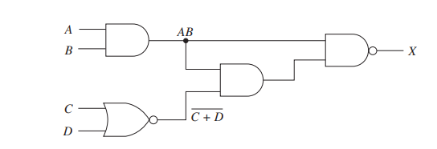
Simplify The Output X And Draw The Logic Circuit For The Simplified Boolean Expression.

Slide 19
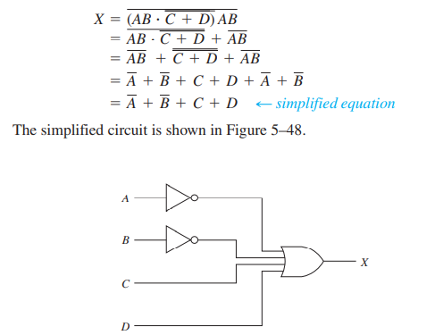

Slide 20
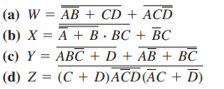
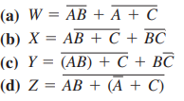
Apply De Morgan’s Theorem And Boolean Algebra Rules To Reduce Them To Equations Having Inversion Bars Over Single Variables Only.

Slide 21
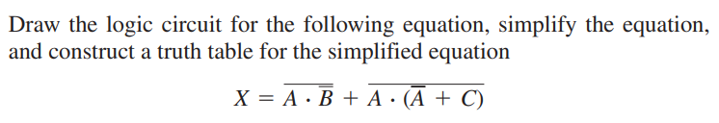

Slide 22
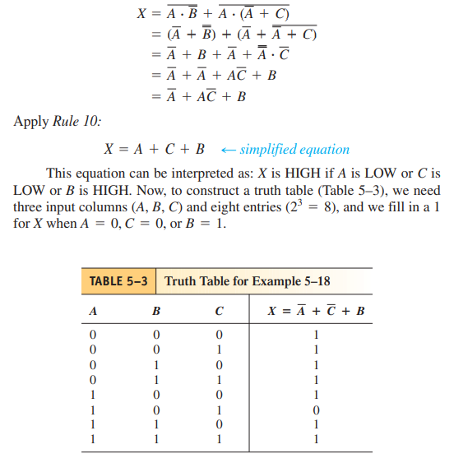
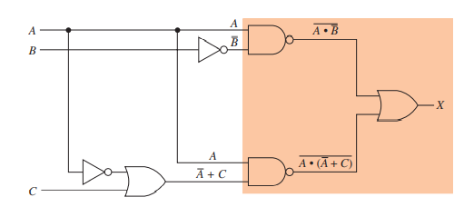

Slide 23


Slide 24
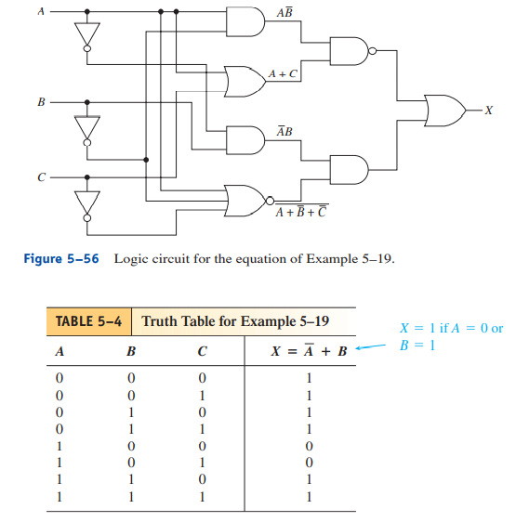
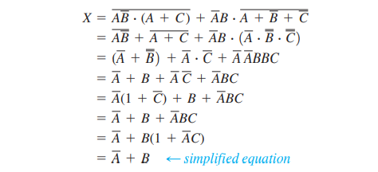

Slide 25
COMPILED BY TA JOHN ALL THE BEST IN YOUR EXAMS THANK YOU

